Slide 1


Self-Examination in Our Time

Slide 2
The Scripture – Engagement Test
Engaging deeply with Scripture leads to stronger discipleship outcomes. Adults with a biblical worldview, which is strongly linked to regular Bible intake, tend to report lower levels of anxiety and fear.
Key tests every Christian should reflect on, Linsey Koros (msn.com)

Slide 3


The Scripture – Engagement Test
Psalm 119:1-6
1 Corinthians 2:11
Study God’s Word!

Slide 4
The worldview Test
According to christianpost.com, only 6% of self-professed Christians hold a biblical worldview amid increasing syncretism in the U.S. This is despite a much larger group self-identifying as Christian. Without effective spiritual renewal, this trend is projected to continue.
Key tests every Christian should reflect on, Linsey Koros (msn.com)

Slide 5

The Worldview Test
1 Peter 4:3-6
God Determines True Discipleship

Slide 6
The Trials and Suffering Test
Navigating life's challenges emphasizes that trials are a regular part of the Christian life, not an exception. Christians with a strong biblical worldview, shaped partly by suffering, tend to experience lower levels of chronic anxiety and fear, proving that trials can build resilient faith.
Key tests every Christian should reflect on, Linsey Koros (msn.com)

Slide 7

The Trials and Suffering Test
James 2:1-4
Suffering matures & Equips A Christian!

Slide 8
The Discipleship Growth Test
Lifeway Research found a significant gap in discipleship satisfaction, with only 8% of U.S. Protestant pastors reporting extreme satis-faction. Many congregations excel in corporate worship yet struggle with disciple-making.
Key tests every Christian should reflect on, Linsey Koros (msn.com)

Slide 9

The Discipleship Growth Test
2 Peter 1:5-11
Become Stronger,
Satisfy God!

Slide 10
The Integrity and lifestyle Test
Many adults base their worldview on personal experiences and feelings rather than logic or Scripture. This makes it easy for believers to drift into moral confusion unless Scripture and community influence their daily choices.
Key tests every Christian should reflect on, Linsey Koros (msn.com)

Slide 11

The integrity and lifestyle Test
Proverbs 14:12
Romans 10:1-4
Scripture Equips You!

Slide 12
The Evangelism Test
Many churches struggle to be effective, even as they affirm the importance of evangelism. Lifeway Research 2025 research confirms that while pastors value discipleship, few churches excel at it, with outreach and evangelism ranking 13% among the top church efforts.
Key tests every Christian should reflect on, Linsey Koros (msn.com)

Slide 13
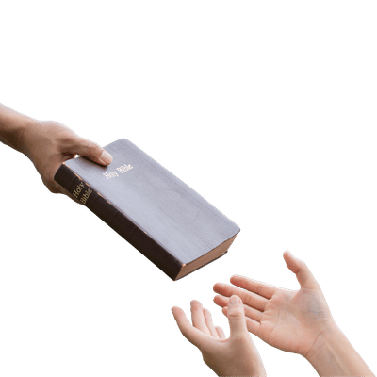
The Evangelism Test
Matthew 5:14-16
Matthew 28:19-20
Preach the Word!

Slide 14
The Next Generation Test
George Barna’s research consistently shows that a person’s worldview is primarily set by age 13, developing rapidly from 18 months, and significant change is rare afterward. This makes early childhood and adolescence key windows for discipleship.
Key tests every Christian should reflect on, Linsey Koros (msn.com)

Slide 15

The Next Generation Test
Ephesians 6:4
Proverbs 22:6
Prepare your children for eternity

Slide 16

Conclusion
You are not in this to please yourself, you are in it to please God!
Galatians 2:20

